Slide 1

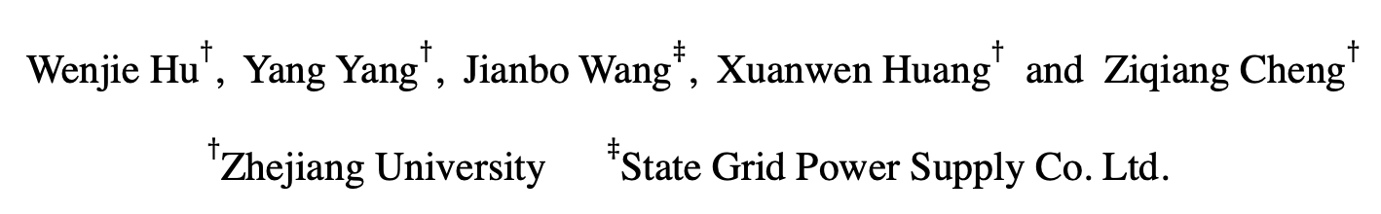
Understanding Electricity-Theft Behavior via Multi-Source Data
Paper ID: 2086
Wenjie Hu$†$, Yang Yang$†$, Jianbo Wang$‡$, Xuanwen Huang$†$ and Ziqiang Cheng$†$
$†$Zhejiang University $‡$State Grid Power Supply Co. Ltd.

Slide 2
Background
Electricity theft is a common illegal behavior in developing countries.
In 2012, GDP in India was reported to drop 1.5% as a result of electricity theft^{[1]};
Uttar Pradesh lost 36% of its total electric power caused by electricity theft.
How does the power suppliers detect
electricity theft?
[1] PR Newswire. 2017. 96 Billion Is Lost Every Year To Electricity Theft: Utilities increasingly investing in solutions to combat theft and non-technical losses.

Slide 3
Background
Hardware-driven Methods^{[2]}:
upgrade the meter structures;
install a centralized;
fully closed meter box.
Drawbacks:
require expert domain knowledge;
hard to design a general structure, due to the various pilfering tactics;
effectiveness loss once thieves change their tactics.
[2] Li-Cai Guo, Zhi-Wei Peng, and Qiang Fan. 2010. A survey of electric energy metering and countermeasures to electric power stealing [J]. High Voltage Apparatus 46, 5 (2010), 86–88.

Slide 4
Background
Data-driven Methods^{[3, 4]}:
analyze electricity usage records of each user
analyze NTL^{[5]} records
Non-Technical Loss (NTL): the energy that is distributed but not billed
Statistics are generally made in units of area (e.g., community, village, etc.)
Drawbacks:
heavy burden for artificial analysis due to the massive data
few labels for model learning
isolated model and fail to obtain good performance
Goal: Identify electricity-theives via multi-source data in a hierarchical view.
[3] ZibinZheng,YataoYang,XiangdongNiu,Hong-NingDai,andYurenZhou.2017. Wide and deep convolutional neural networks for electricity-theft detection to secure smart grids. IEEE Transactions on Industrial Informatics,
[4] SomaShekaraSreenadhReddyDepuru,LingfengWang,andVijayDevabhaktuni. 2011. Support vector machine based data classification for detection of electricity theft. In Power Systems Conference and Exposition (PES). IEEE, 1–8.
[5] Abhishek Chauhan and Saurabh Rajvanshi. 2013. Non-technical losses in power system: A review. In International Conference on Power, Energy and Control (ICPEC). IEEE, 558–561.

Slide 5
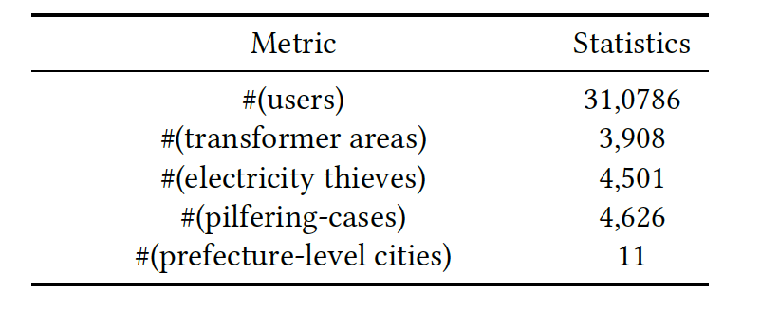
Hierarchical Structure of Power Grid Data
Data：(~2 years, from June 2017 to April 2019)
310,786 electricity usage records of user,
3,908 NTL records of transformer areas,
11 weather records of prefecture-level cities.
1.45%
Macro-level:
How does these information reveal
electricity-theft behaviors together?
Meso-level:
Micro-level:

Slide 6
Observation in Micro-Level (User)
Different pricing electricity (wiki: https://en.wikipedia.org/wiki/Electricity_pricing)
when the thief was caught
Usage variations before and after on-site checking：
The weather gets cooler from Jul. to Oct.
Thieves
Normal
users
The slope of normal user tends to be negative, while half of thieves have a positive one
1. Significant increment after being caught
2. Normal users consume less power and perform stable

Slide 7
Observation in Meso-Level (Area)
when the thief was caught
1. The less usage, the higher the NTL
2. After on-site checking, the NTL became stable.
Usage increases and NTL drops after being caught, indicating that NTL is a signal for electricity theft
Normal users perform stable and regular

Slide 8
Observation in Macro-Level (Climate)
Statistics: the number of electricity thieves in each month
Summer
Winter
Climatic conditions would influence the user behavior of electricity usage (e.g., the usage of the air conditioner, heaters, etc.) and lead people to pilfer electricity.
The correlations between temperature and total electricity usage
Temperature is able to guide user behaviors of electricity usage
Increased electricity with the high temperature
Increased electricity with the low temperature

Slide 9
Observation in Macro-Level (Climate)
Wasserstein distance
The gap between thieves and normal users is larger under extremely high or low temperatures
1. The scatterplot of electricity thieves seems disordered and irregular
2. The scatterplot of normal users is well fitted to a specific quadratic curve

Slide 10
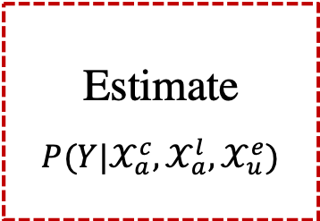
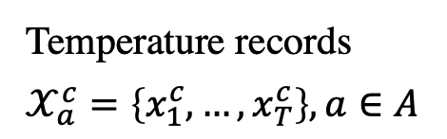
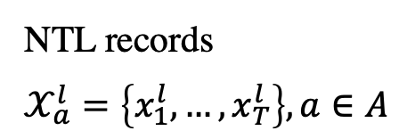
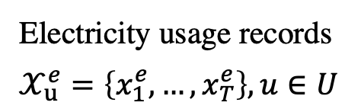
HEBR: Hierarchical Electricity-theft Behavior Recognition
HEBR aims to bridge the information from different sources and capture their hierarchical correlations when detecting electricity theft.
Temperature records
$$𝒳_{a}^{c}=\left\{x_{1}^{c},…,x_{T}^{c}\right\},a∈A$$
Macro-level:
Estimate
$${P(Y|𝒳}_{a}^{c},𝒳_{a}^{l},𝒳_{u}^{e})$$
NTL records
$$𝒳_{a}^{l}=\left\{x_{1}^{l},…,x_{T}^{l}\right\}, a∈A$$
Meso-level:
Electricity usage records
$$𝒳_{u}^{e}=\left\{x_{1}^{e},…,x_{T}^{e}\right\}, u∈U$$
Micro-level:

Slide 11
HEBR: Hierarchical Electricity-theft Behavior Recognition
HEBR contains three levels of feature extraction and hierarchical fusion
model the influence from macro/meso to micro info.
uniform the influence from macro and meso level.
estimate the probability of electricity theft.

Slide 12
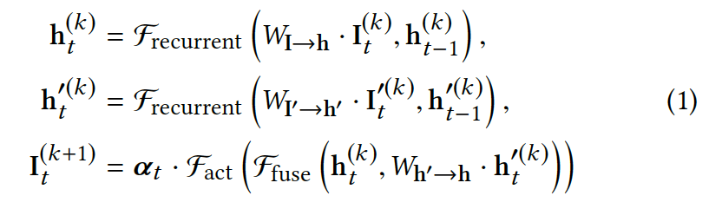
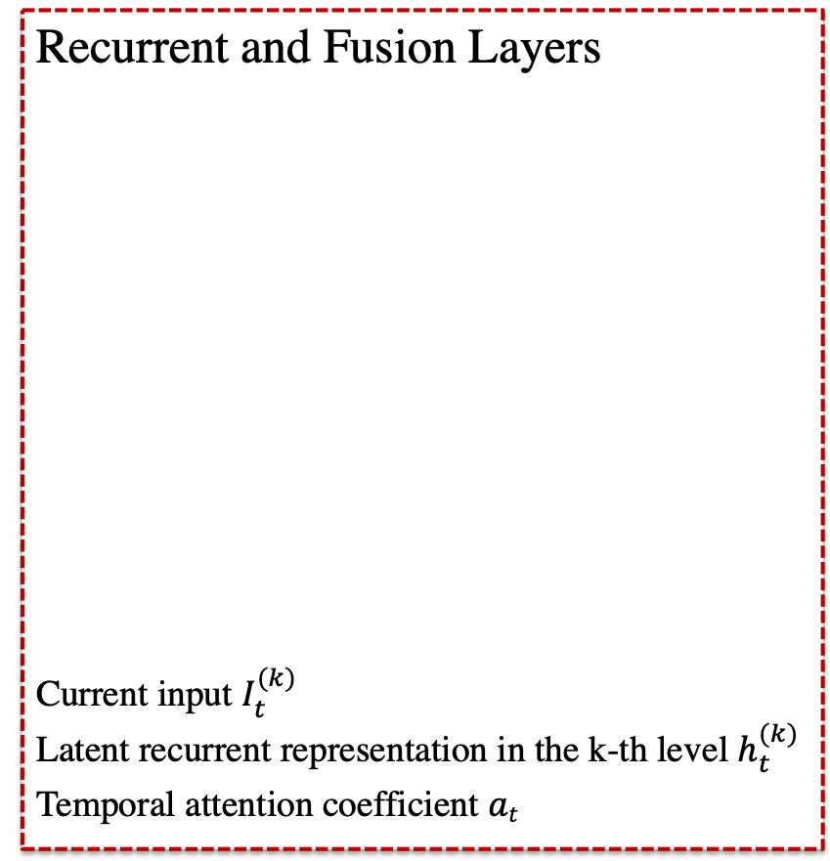
HEBR: Hierarchical Electricity-theft Behavior Recognition
Recurrent and Fusion Layers
Current input $I_{t}^{(k)}$
Latent recurrent representation in the k-th level $h_{t}^{(k)}$
Temporal attention coefficient $at$

Slide 13
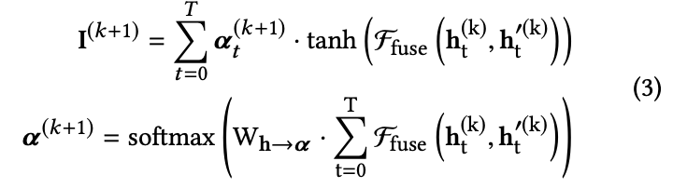
HEBR: Hierarchical Electricity-theft Behavior Recognition
Multi-step fusion mechanism
Temporal attention highlight the significance of the fused information at different time step

Slide 14
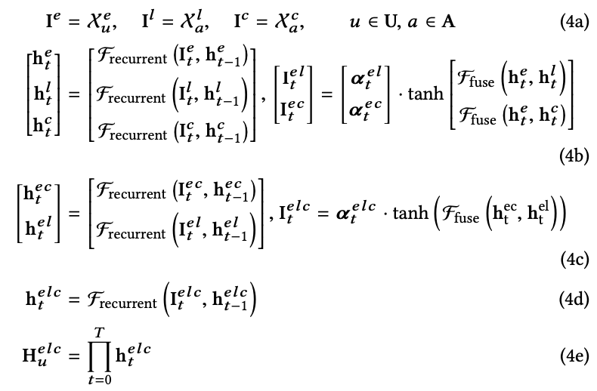
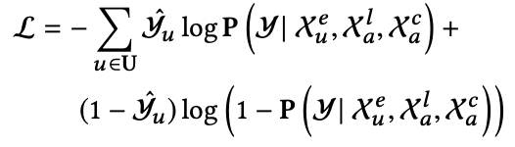
HEBR: Hierarchical Electricity-theft Behavior Recognition
Formulation and Learning
Binary cross-entropy loss:

Slide 15
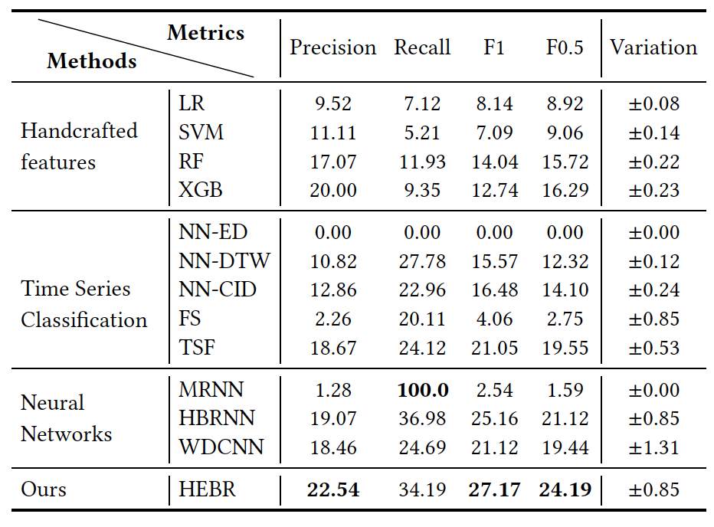
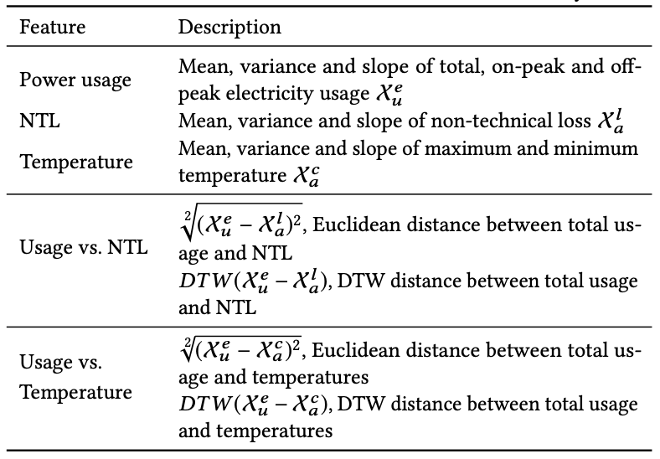
Experiments
Baseline methods
Handcrafted features

Slide 16
Experiments
Baseline methods
Handcrafted features
Time Series classification^{[1][2] [3] [4]}
Neural Networks ^{[6][7] [8]}
HEBR(Our approach)
[1] Donald J and James C. 1994. Using dynamic time warping to find
patterns in time series. SIGKDD (1994)
[2] Gustavo EAPA B, Xiaoyue W, and Eamonn J K 2011. A complexityinvariant
distance measure for time series. SDM (2011
[3] Thanawin R and Eamonn K. 2013. Fast shapelets: A scalable algorithm for discovering time series shapelets. ICDM (2013)
[4] Houtao D, George R, Eugene T, and Martyanov V 2013. A time series forest for classification and feature extraction. Information Sciences 239 (2013)
[5] Alex G, Abdelrahman M, and Geoffrey E H. [n.d.]. Speech recognition with deep recurrent neural networks. International Conference on Acoustics, Speech, and Signal Processing (ICASSP)
[6] Alex G, Abdelrahman M, and Geoffrey E H. [n.d.]. Speech recognition with deep recurrent neural networks. (ICASSP)
[7] Yong D, Wei W, and Liang W. 2015. Hierarchical recurrent neural network for skeleton based action recognition. In Proceedings of the IEEE conference
on computer vision and pattern recognition
[8] Zibin Z Yatao Y, Xiangdong N, Hong-Ning D, and Yuren Z 2017. Wide and deep convolutional neural networks for electricity-theft detection to secure smart grids. IEEE Transactions on Industrial Informatics 14, 4 (2017)

Slide 17
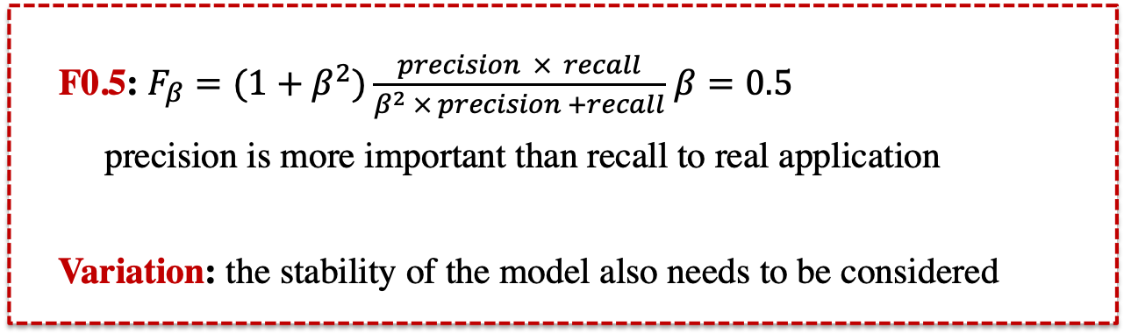
Experiments
F0.5: $F_{β}=(1+β^{2})\frac{precision × recall}{β^{2} × precision +recall}$ $β=0.5$
precision is more important than recall to real application
Variation: the stability of the model also needs to be considered

Slide 18
Experiments

Slide 19
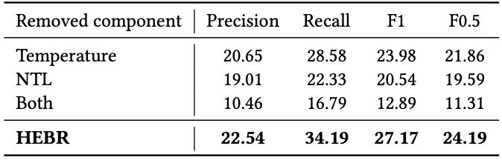
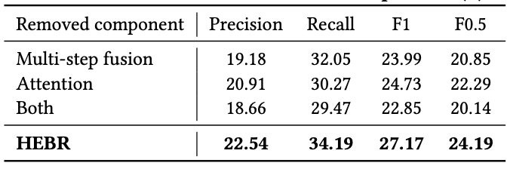
Effectiveness Validation
Several ablation studies are conducted to validate the model effectiveness
Effect of multi-source information
Effect of fusion and attention operators

Slide 20
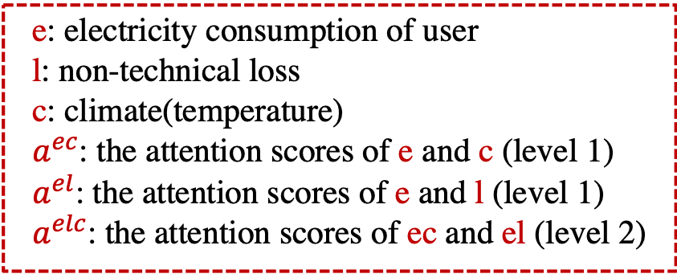
Real World Application
Our work has been applied by State Grid of China to successfully catch electricity thieves in Hangzhou with a precision of 15%
when the thief was caught
e: electricity consumption of user
l: non-technical loss
c: climate(temperature)
$a^{ec}$: the attention scores of e and c (level 1)
$a^{el}$: the attention scores of e and l (level 1)
$a^{elc}$: the attention scores of ec and el (level 2)

Slide 21
Real World Application
Our work has been applied by State Grid of China to successfully catch electricity thieves in Hangzhou with a precision of 15%
when the thief was caught

Slide 22

Conclusions
Analyze electricity-theft behaviors from three distinct levels of information based on multi-source data.
Propose the Hierarchical Electricity-theft Behavior Recognition (HEBR) model based on observational studies, which identifies electricity theft by fusing different levels of information, and validate its effectiveness using a real-world dataset.
Apply HEBR to catch electricity thieves on-site and achieve significant performance improvements.
Thanks! Q&A
More relevant research of our group: yangy.org
Contact: yangya@zju.edu.cn

